Slide 1
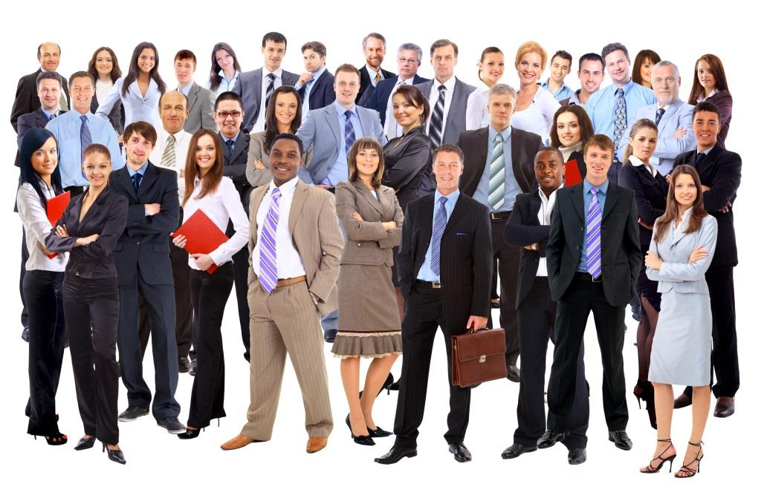
Seattle-Tacoma
Job Fair
Demographics

Slide 2
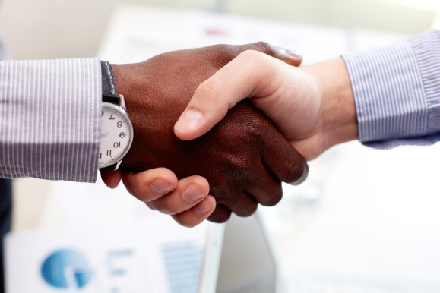
Importance to Community
Brings employers and employees together
Helps the unemployed find jobs
Helps the underemployed find better jobs
Improves the financial health of our community

Slide 3
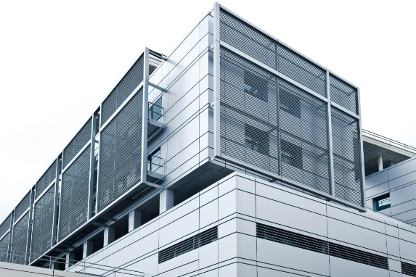
Companies Attending
A few of the 50 companies attending are:
  Birch Bros. Technologies
  Pacific Rim Adjustors
  Dykstra & Herwig
  Lakewood Marketing
  Drake Consulting
  HMM Advertising
  Pro-Temps, Inc.

Slide 4
Age of Attendees

Slide 5
Attendees Currently Unemployed

